Slide 1
LOAN MANAGEMENT SYSTEM
Using MySQL by
Kartheek kumar R

Slide 2
Introduction of SQL
SQL Servers
SQL Statements
MySQL General Functions
Projects
CONTENTS

Slide 3
Introduction of SQL
SQL (Structured Query Language) is a domainspecific language used for managing and manipulating data in relational database management systems (RDBMS).
SQL is important because it allows users to query databases, retrieve data, modify data, and perform various operations on data.
Relational databases are a structured way to store and manage data, with data organized into tables with predefined relationships

Slide 4
SQL Servers
MySQL
Oracle
PostgreSQL
SQL Server (Microsoft Server)
MongoDB
NoSQL

Slide 5
SQL Statements
DDL - Data Definition Language
DML - Data Definition Language
DQL - Data Query Language
DCL - Data Control Language
TCL - Transaction Control Language

Slide 6
SQL COMMANDS
DDL - Data Definition Language
DML – Data Manipulation Language
Database creation
Alter database
Table creation
Alter table
Alter header
Truncate table
Insert values
Delete values
Update values
DCL – Data Control Language
Grant
Revoke

Slide 7
DQL - Data Query Language
General functions : Where, Or, And, In, Not in, Count, Distinct, Group by, Like, Not Like.
Aggregate (or) Calculated Function : Sum, Min, Average, Maximum.
String function : Lcase, Ucase, Left, Right, Concat, Length, Mid.
Logical function : If condition, If with or, If with and, Nested if .
Date function : Date add, Timestamp diff, Month, Day, Date format, Year.
Join queries : Inner join, Left join, Right join, Full outer, Cross join.

Slide 8
Loan Management System Project
Project Summary:
The Loan Management System project is designed to manage and automate various aspects of loan processing and customer data management. By working with key datasets and applying criteria-based classifications, triggers, and stored procedures, this system efficiently handles loan applications, customer statuses, and interest calculations.
Objective:
The project aims to analyze customer income status to categorize customers based on their financial standing.
Calculate loan amounts, monthly and annual interest, and update customer CIBIL scores.
Automate the loan approval process by using triggers for real-time status updates and by filtering customers based on defined criteria.

Slide 9
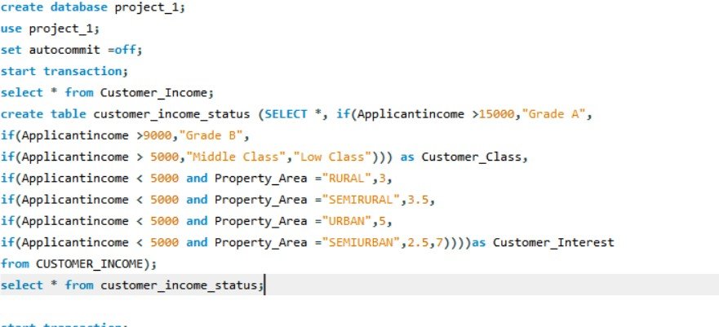
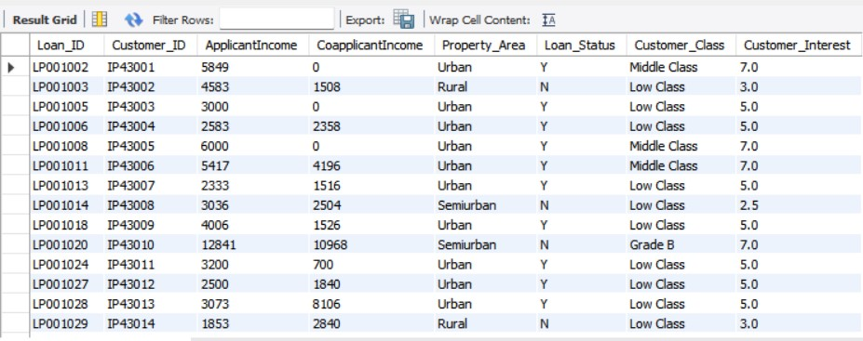
Grade and Interest Percentage status
Adding grades to the customer and setting customer interest percentage for customer_income table and creating a new table customer_income_status.

Slide 10
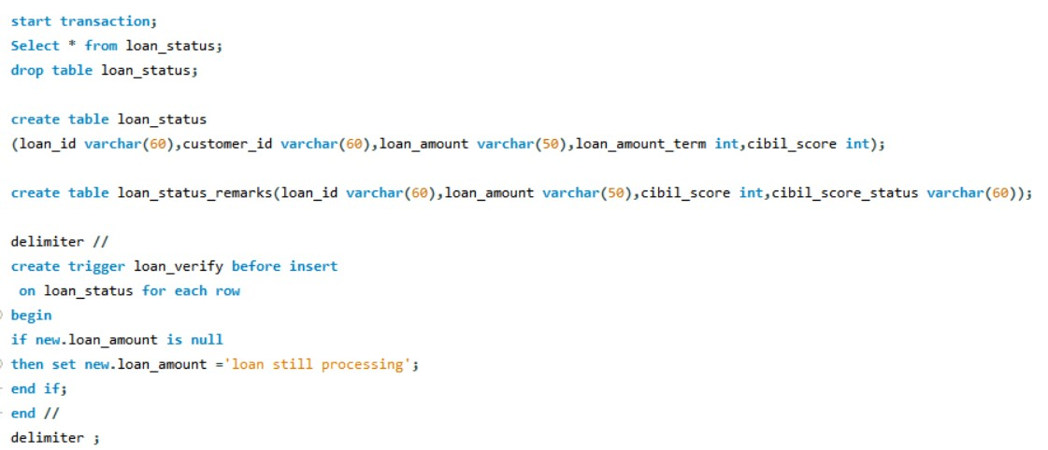
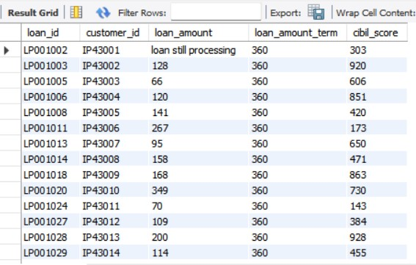
Row level Trigger
Creating loan_status table and loan_status_remarks table .Creating a row level trigger so that if loan_amount is null then setting loan amount as loan still processing.

Slide 11
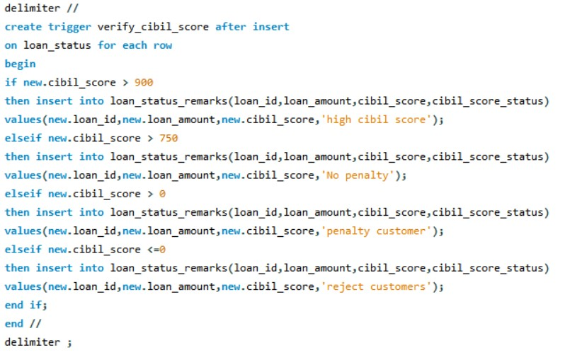
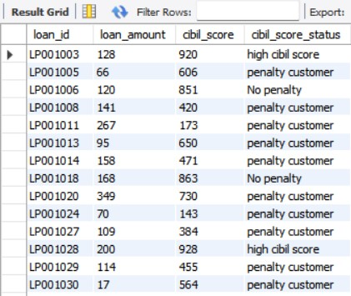
Statement level trigger

Slide 12
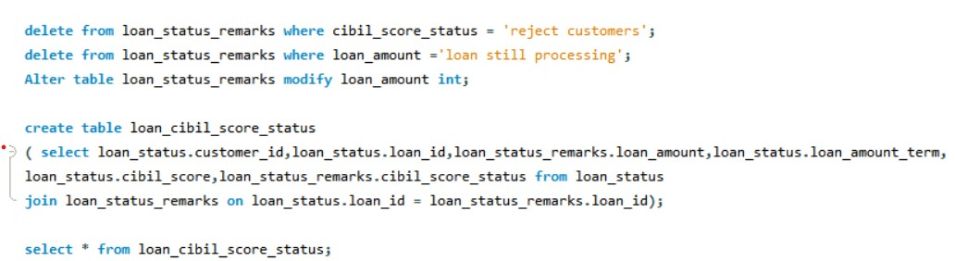
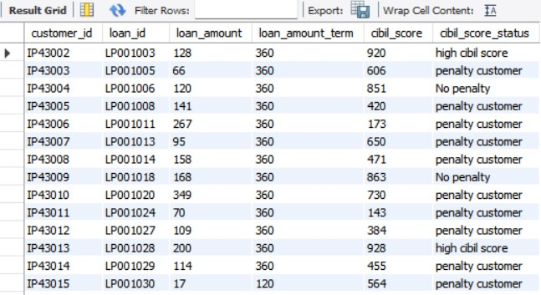
Loan Cibil Score Status
Performing delete operation by deleting customers whose cibil_score_status is rejected and deleting customers whose loan_amount is still processing from loan_status_remarks. Creating a new table and naming it as loan_cibil_score_status by joining loan_status table and cibil_score_status.

Slide 13
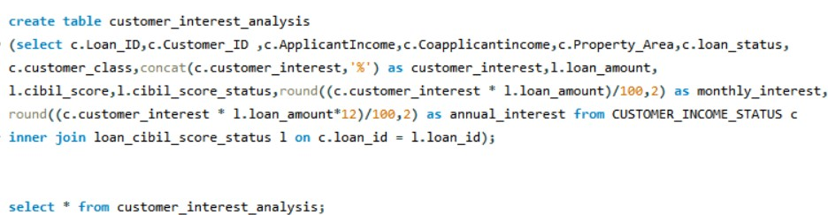
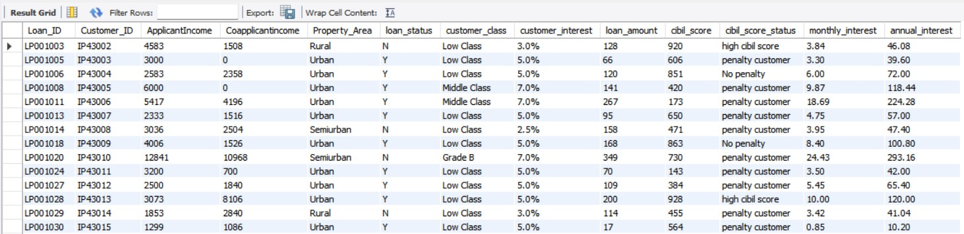
Customer interest analysis

Slide 14
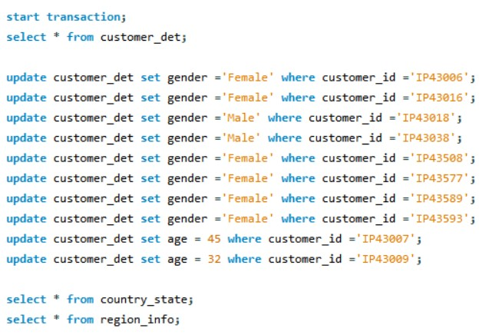
Performing DML Operations
Performing update operation on gender and age for customer_det table.

Slide 15
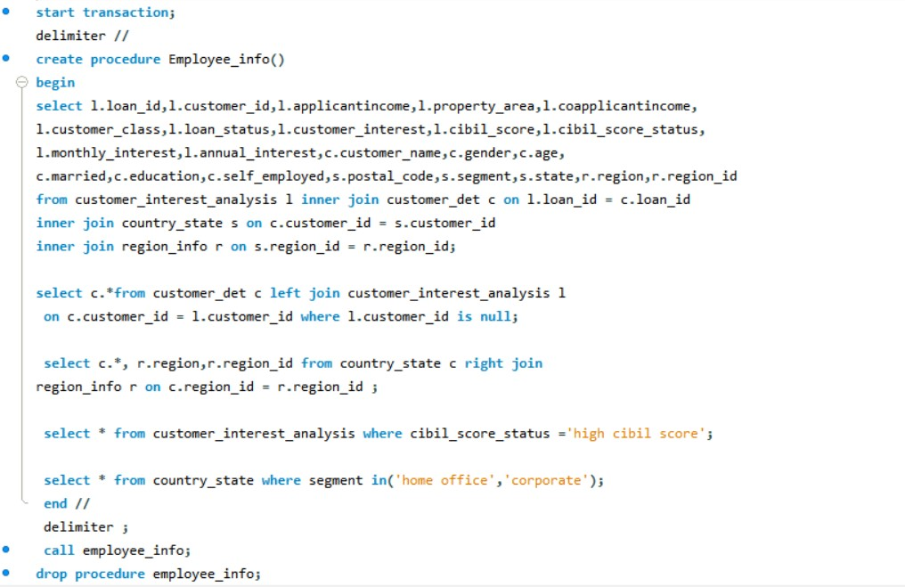
Procedure

Slide 16
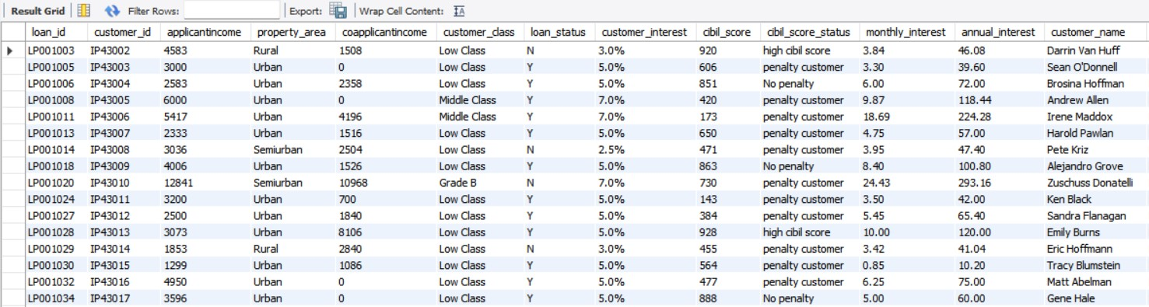
Output - 1.1
Join all the 5 tables without repeating the fields using joins.

Slide 17
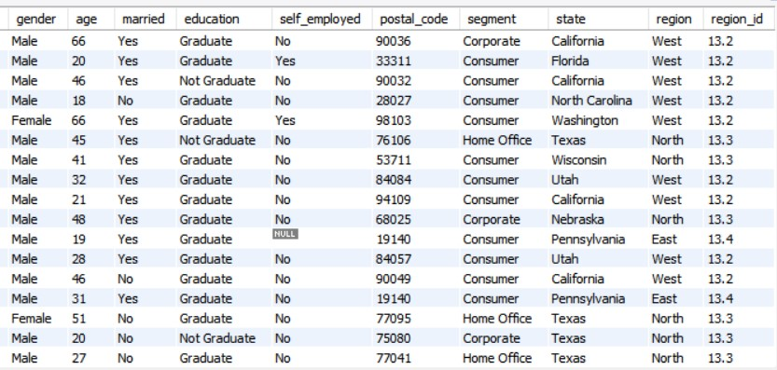
Output - 1.2

Slide 18
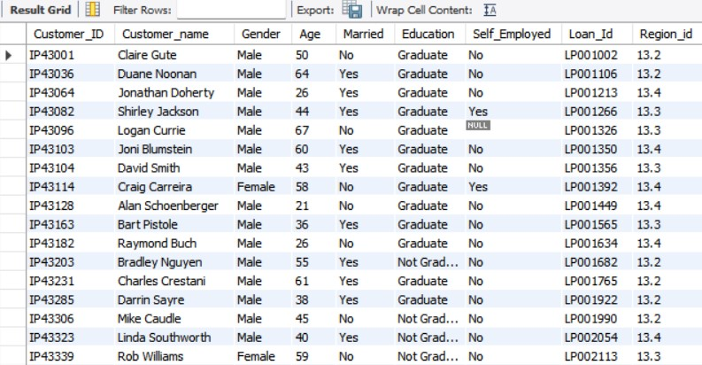
Output - 2.1
Displaying Mismatched details using joins

Slide 19
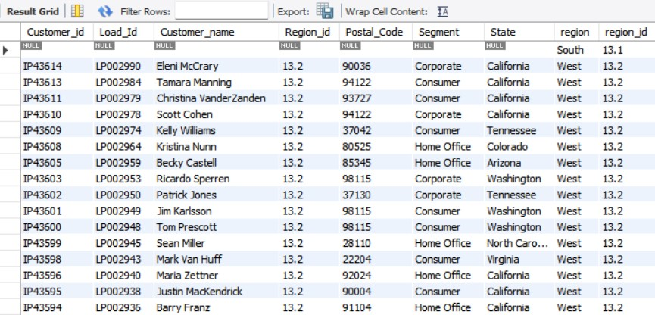
Output - 2.2

Slide 20
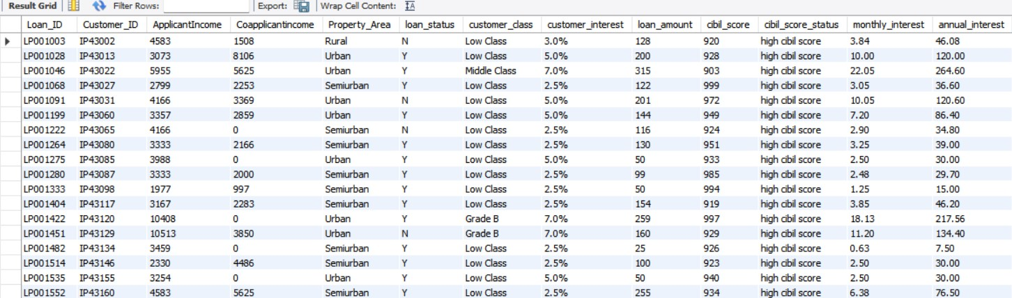
Output - 3
Filtering information of high cibil score customer from cibil_score_status using inner join.

Slide 21
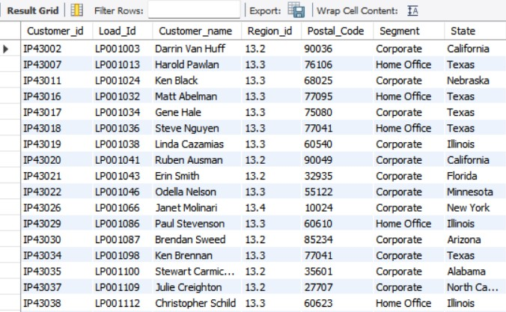
Output - 4
Filtering information of customer whose segment is Corporate or Home Office from cibil_score_status using inner join.

Slide 22
THANK YOU

